Slide 1
My Account Configurations
LEVEL - PRACTITIONER

Slide 2
About the Author
About the Authorbout the Author
Created By: | Saibal Roy, Supriyo Saha
Credential Information: | Sr. Consultant – CRM, EAS Salesforce
Version and Date: | V1, 13-Jan-2018, V1.1: July-2023:Updated with Lightning UI
Modified By: | Souvik Biswas

Slide 3
Recap ...
In the previous Module - VEEVA Settings and VEEVA Messages, you learnt to:
  Describe how VEEVA Settings are used
  Describe various fields of a VEEVA Message Record
  Create a custom VEEVA Message
  Identify the uses and best practices for VEEVA Marker Fields
And now ...

Slide 4

Objectives
After completing this chapter, you will learn to:
  Define ‘My Accounts’
  Create Views
  Create Lists
  Configure the My Accounts tab:
    Hide the Mass Update button
    Configure the Schedule a Call button
  Configure the New button:
    Enable New Account Wizard
    Enable Parent Account Wizard
  Use the VEEVA Global Account Search
  Describe My Accounts on CRM (iRep)

Slide 5

Objectives
My Accounts tab is one of the most customized VEEVA tab. This is a custom VEEVA User Interface runs on VEEVA servers
This tab can bring and show data from 4 objects in a single view - Accounts, Address, Product Metrics, Territory Fields
My accounts tab is being used to view and manage customers for end users

Slide 6

Do You Know
The Accounts displayed in the My Accounts page are based on the value selected from the Territory picklist which contains the territories to which the user is assigned and for which account the user has visibility
The Schedule a Call Button can be added to the My Accounts page allowing the user to create call records for a selected account or multiple accounts
The Mass Update button on My Accounts can be removed from the My Accounts page by enabling the DISABLE_MASS_UPDATE VEEVA Setting
The fields displayed in the My Accounts list cannot be configured. However, the fields, sections and layout in the account detail page can be configured using standard salesforce.com setup and configuration

Slide 7
My Account Configurations
My Accounts

Slide 8



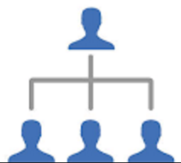
VEEVA Account Overview
People are
classified as
Person
Accounts in
VEEVA rather
than Contacts
Include both
Business
and Person
Accounts
Managed via
the Accounts
SFDC
standard
Object
Includes
fields from
both
Accounts and
Contacts

Slide 9
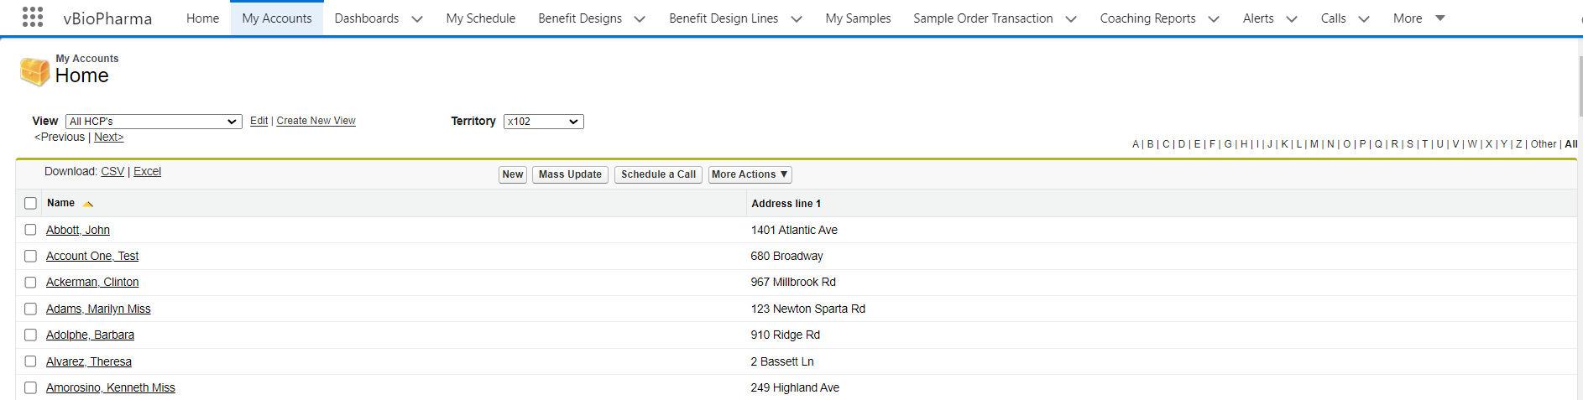
My Accounts Tab
My Accounts Tab is a custom VEEVA page based on an s-control. Displays accounts from the territories to which the user is assigned and for which account the user has visibility
Note:
My Accounts displays data from 4 different objects side-by-side: Accounts, Address, Territory Field, and Product Metrics. This could not have been achieved in OOB Salesforce Accounts Homepage

Slide 10
My Accounts- Views & Territory Filters ... 1
Views are saved queries that filter the Accounts displayed on My Accounts page
Views are typically created by Admins and/or power users and made available to end users
Territory picklist filters the Accounts list and displays only accounts aligned to the selected territory
Note:
  Only users who have permission to create and edit Views will see the EDIT and CREATE NEW VIEW links- in between View name and Territory placeholders (pick lists)
  Manager level Territory picklists display all of the territories that directly roll-up to the selected territory in the Territory Hierarchy

Slide 11
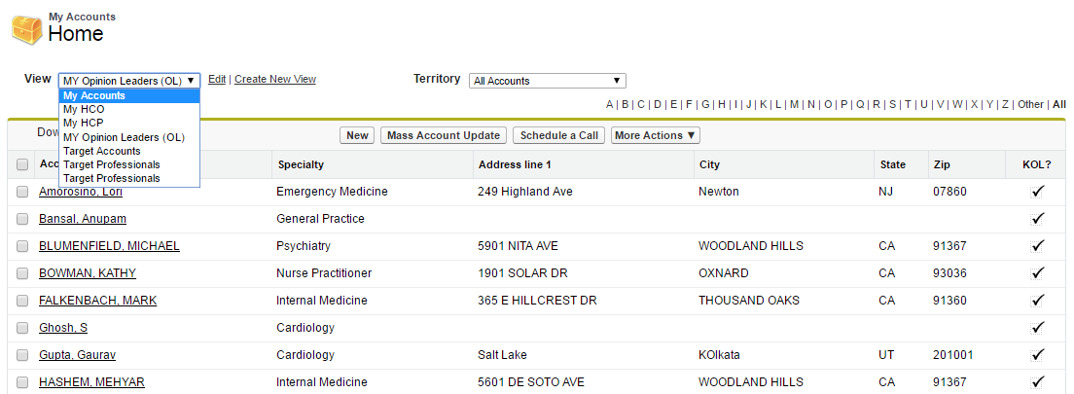
My Accounts- Views & Territory Filters ... 2
Below is a screenshot showing the view create and territory selection from My Accounts tab
Users who have permission to create and edit Views will see these links
Users can change the territory to see accounts related to that

Slide 12
My Account Configurations
My Account Configurations

Slide 13


My Accounts - Configuration
My Accounts tab requires user profiles to have the following object permissions:
  Read-Write privileges on the following objects:
    Account
    Address
    Product Metrics
    Territory Fields
    Preferences
  Assign Read-Write-Delete privileges to the View object

Slide 14
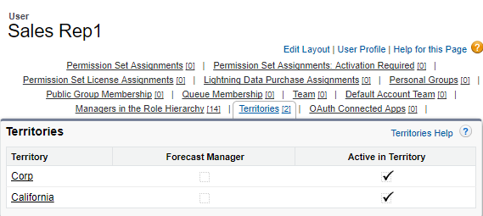
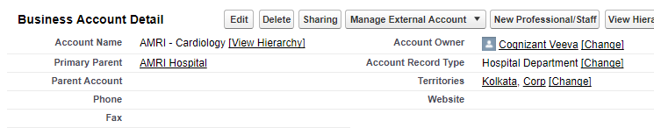
My Accounts - Configuration
For Accounts to display on My Accounts Homepage:
  Territory Hierarchy must be set up. The My Accounts page is dependent on having the Territory Hierarchy established with users assigned to territories
  Assign Accounts to the appropriate territories through Territory Management
  Users must be assigned to Territories

Slide 15
My Accounts Lists Threshold
My Accounts lists can display up to 5000 records
Use the MAX_ACCT_THRESHOLD VEEVA setting to raise the limit above the default 5K. 5K limit is imposed by default
There are performance implications when raising this limit. Queries of larger sets of data take longer to return results. The decision to raise this limit should be carefully considered

Slide 16
My Account Configurations
My Accounts - Views

Slide 17
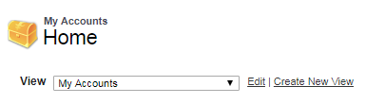
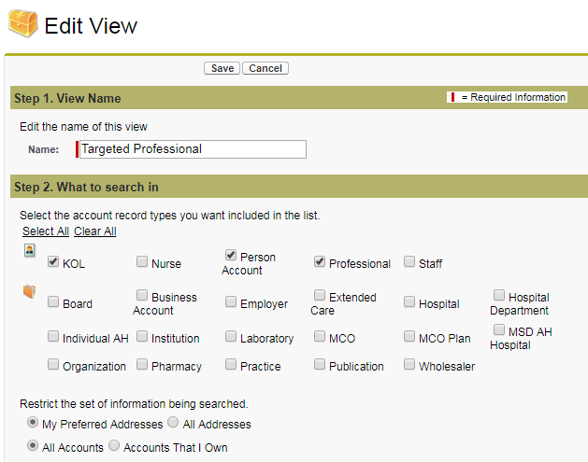
Create New Views for Users ... 1
Steps to follow to create new View:
Go to My Accounts tab
Click the Create New View link
Enter View Name. (Step 1 in screen)
Select the type of accounts to display in the view. Don’t select record types the org is not using. (Step 2)
Select My Preferred Addresses and All Accounts. (Step 2 in screen)
  Selecting My Preferred Addresses will prevent accounts with multiple addresses from being displayed more than once
  The address that will be used is the last address used on a call. If no address has been used, then the primary address will be used

Slide 18
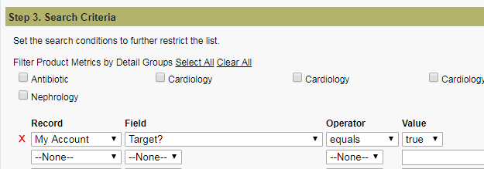
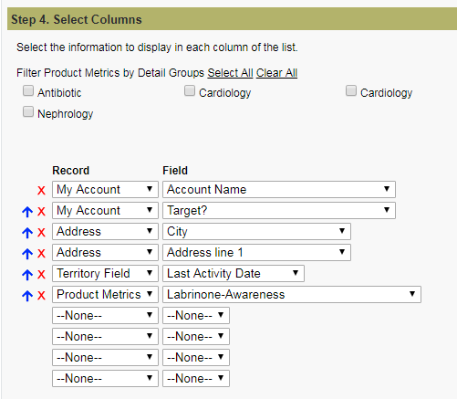
Create New Views for Users ... 2
6. Select criteria from the 4 objects:
  Account, Address, Territory, Product Metrics. (Step 3 in screen)
7. Select the columns to display on the new view. (Step 4 in screen).
  Profiles must have at least Read FLS access to fields used in Search Criteria and Selected Columns
8. Use arrows to change the order. (Step 4 in screen)

Slide 19
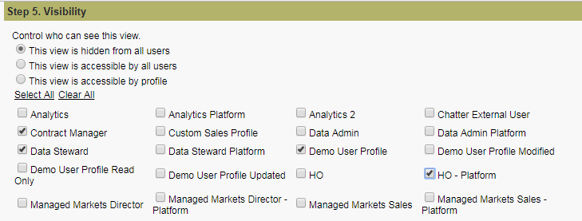
Create New Views for Users ... 3
9. Select the Profiles who can see the view (Step 5 in screen)

Slide 20
My Account Configurations
Creation of Lists

Slide 21
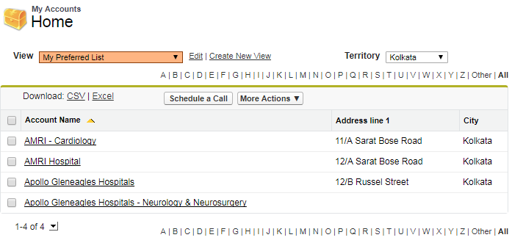
Account List- Definition & Functionality ... 1
Using an Account List:
  Users can organize their Accounts into lists that are meaningful and valuable to them
    Easily schedule calls for the Accounts in the list
  Similar to Playlists in iTunes
  Seamlessly integrated into the My Accounts tab
    Each list is available for selection in the Views dropdown
  Lists are static but views are dynamic
  Admins can associate a color to each list for visual representation

Slide 22
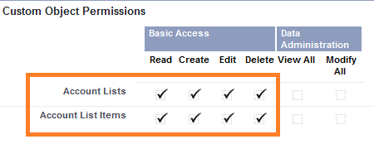
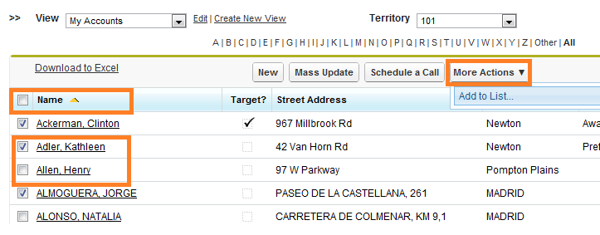
Account List- Definition & Functionality ... 2
User profiles need full CRUD permissions on the following objects to create or modify account lists
Admins can add/remove an account to/from a list by- selecting Account(s) and by clicking on More Actions to create new list

Slide 23
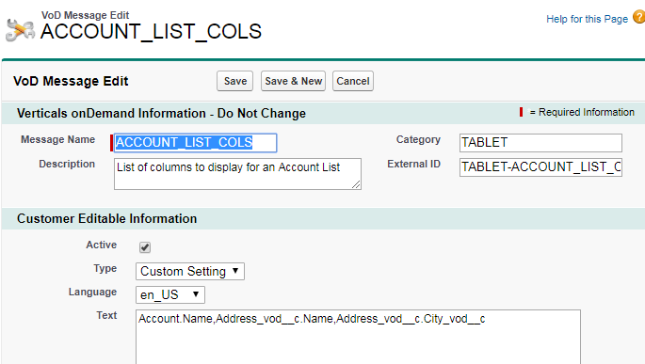
Account List- Definition & Functionality ... 3
Account List Setup:
  Modify ACCOUNT_LIST_COLS VEEVA Message to display Account and Address columns in Account Lists
        Syntax: Address_VOD__c.Zip_VOD__c.
Field API Name
Field API Name

Slide 24
My Account Configurations
Configuration of My Accounts

Slide 25
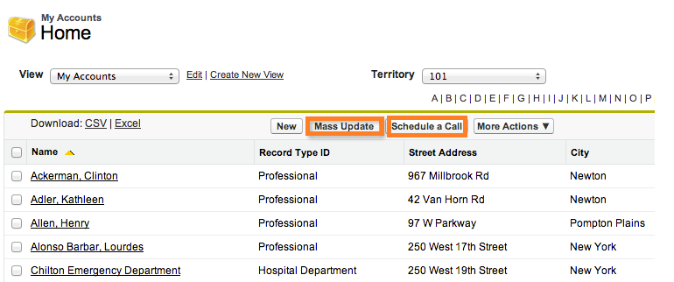
Schedule a Call & Mass Update
Schedule a Call is displayed only if-
  User has access to the My Schedule tab in user profile
  My Schedule tab set to default on
Mass Update:
  To remove from page:
    Set the VEEVA custom setting DISABLE_MASS_UPDATE to true at either the company or profile level
  To change the button label:
    Change MASS_UPDATE VEEVA Message

Slide 26
My Account Configurations
New Account

Slide 27
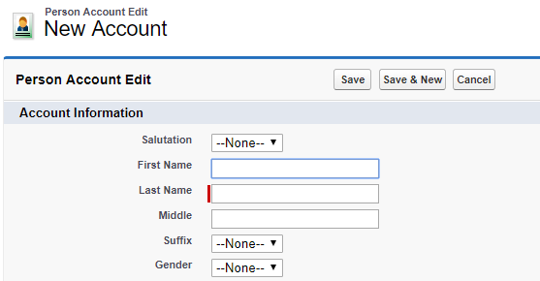
Account Wizard- New
There are Three ways to create an Account in VEEVA CRM:
New Account Wizard (standard):
  Allows users to create an account and corresponding address at the same time
Standard Salesforce:
  If New Account wizard is disabled, the SFDC record creation page will be used
  This process does not do global search
  User will be responsible for entering address separately
Parent Account Wizard:
  Allows users to create an account and associate a parent account and address/addresses at the same time
Standard Salesforce Wizard

Slide 28
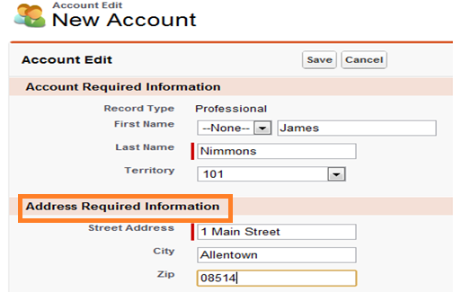
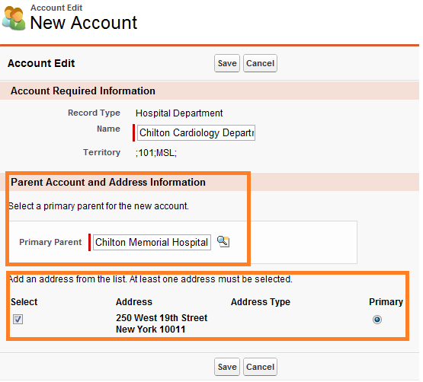
New & Parent Account Wizards
Stream-lined New account creation wizard:
  Create account with license information and corresponding address simultaneously
  Soundex search is performed to identify a possible duplicate
  Searches only for accounts in the user’s territory
Parent Account Wizard:
  This wizard creates hierarchy relationship with Parent account for the new account
  Automatically associates existing address/addresses of the parent account to the child
New Wizard
Parent Wizard

Slide 29
Enabling New Account & Parent Account Wizards
Admins must set the VEEVA custom setting NEW_ACCOUNT_WIZARD to True
  Required fields on the Account and Address page layouts are included in the wizard
  The wizard can also be configured to capture
Account license information
Applicable to person accounts
  To enable the Parent Account Wizard, set the following VEEVA custom settings to True

Slide 30
My Account Configurations
Global Account Search

Slide 31
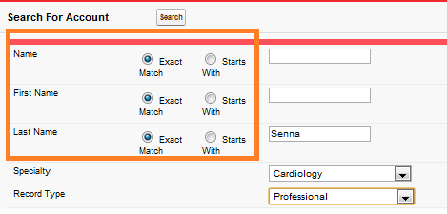
GAS- Define & Enter Criteria
Global Account Search feature allows users to search the entire account universe, that includes business and person accounts outside the user’s territory. To Access:
  Click on the Global Account Search Tab
Note:
  To execute search, user must input value in at least one search field
  First/Last Name and Name fields can't be searched for a value, instead there is a matching mechanism- either exact match or keyword match

Slide 32
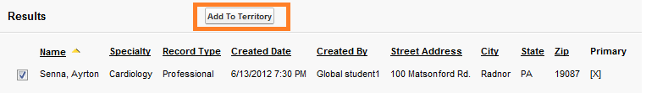
GAS - Execution & Deployment
EXECUTION- Once the Account(s) is located-
  User can select the needed Account(s)
  Click the ‘Add to Territory’ button
  The Account(s) is then added to the user’s territory
  VEEVA CRM offers flexibility to build custom actions to be performed for the selected account(s)
    A maximum of 20 search results is returned. EXECUTION- Once the Account(s) is located
Deployment-
  The Global Account Search is NOT available OOB in VEEVA CRM
    VEEVA Consultant must deploy the GAS application components into an org
    Use Eclipse with the Force.com plugin to deploy
    Obtain the Global Account Search installer.zip file from VEEVA
    Follow instructions to create the Eclipse project and deploy the application components to an org

Slide 33
My Account Configurations
My Accounts on CRM (iRep)

Slide 34
My Accounts
CRM Users can view all the accounts they have access to
My Accounts displays the account name, preferred address and Account phone number.
  If preferred address does not exist, it will show the primary address
  If a primary address is not identified, the first address is displayed
Each row also has an icon that reflects the record type of the account
CRM users can scroll or search for accounts
The user has the ability to filter the list of accounts by using type-ahead search through the search box in the toolbar
Tap the Search box at the top of the screen to initiate a type-ahead search
The index bar displays down the right edge of the list. Record type filters display on the left side of the screen
The user also has the ability to create a new call, launch media, or drill into an account from the My Accounts list

Slide 35
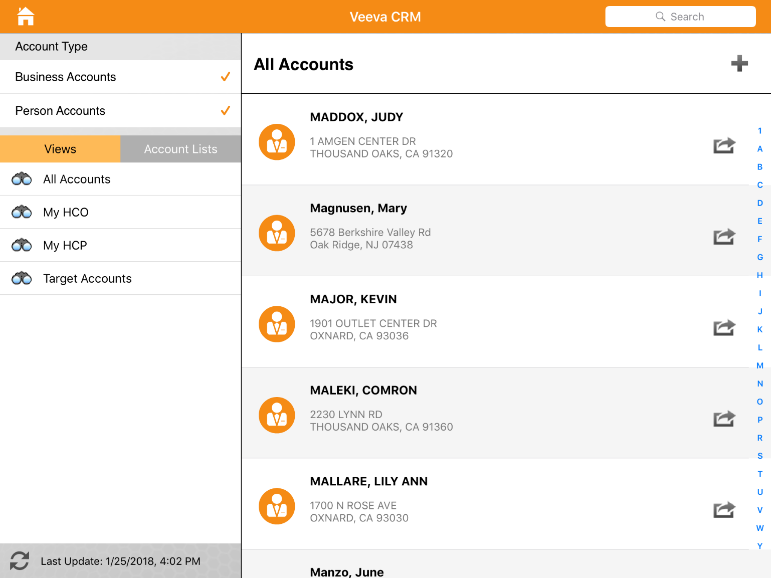
My Accounts
Below is screenshot from iRep application for ‘My Accounts’ tab
User can toggle between business and person accounts
User can select views and account lists as needed
Navigation Bar

Slide 36
My Accounts- Configuration
Specialized functionality is accessed by placing custom buttons and S-controls onto the page layout
These elements are described in the following table:
Element | Type | Specialized Functionality
Record_a_Call | Button | Exposes the Record a Call button in the My Accounts list and detail pages. The user must also have to create privileges on the Call2_vod object.
Account_Summary | Button | Exposes the Account Summary button on the account detail page. Navigates to the online Account Summary report. The user must have read privileges on the Sales_Transaction_vod object
View_Hierarchy_vod | Button | Exposes the View Hierarchy button on the account detail page. Opens a new window containing a graphical representation of related child and parent accounts
MultiChannel_Calendar_vod | Button | Exposes the Calendar button on the account detail page. Opens a new window showing all activities against the account.
Account_Territory_Info_vod | S-Control | When placed on the page layout, this control displays territory specific fields corresponding to the account and the user’s territory. The fields displayed are controlled by the page layout of the corresponding record type in the TSF_vod object. The user must have read privileges on the TSF_vod object.
Ratings_vod | S-Control | Exposes the product metrics grid when placed on the account page layout. Configuration guidelines are described in the VEEVA CRM Version 14 Administration Guide.
SphereofInfluence_Vod | S-Control | Exposes the Sphere of Influence operation button on the account detail page.

Slide 37
Additional Account Identification
VEEVA CRM allows to display parent account information for HCPs to help quickly identify the correct account on iRep
  VEEVA Admins must set the ENABLE_ACCOUNT_PARENT_DISPLAY custom setting to True

Slide 38
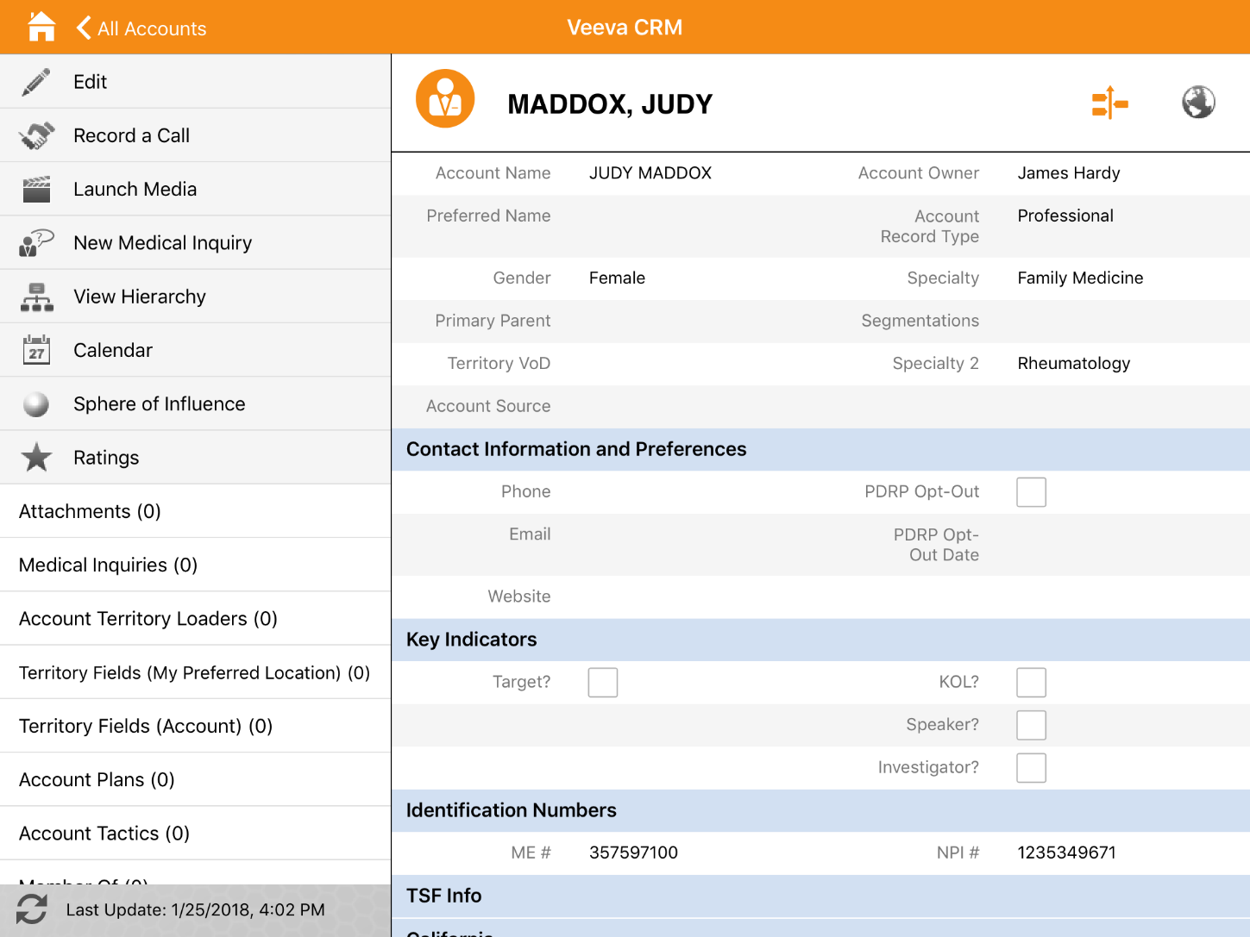
Account Detail on iRep
Actions
Related List
Account Details

Slide 39
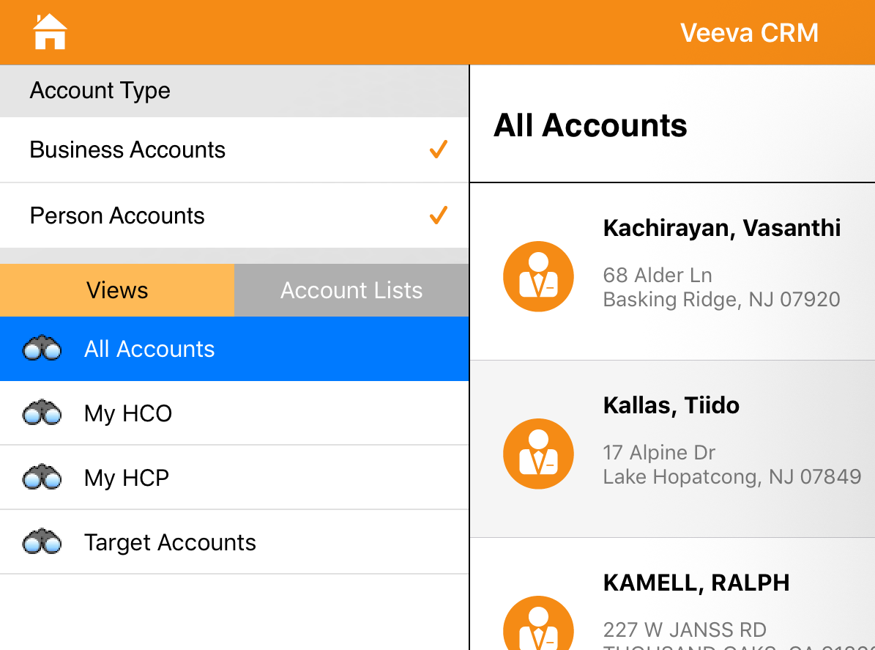
Account Views
Users can access Account Views offline
Views are defined online and synced to iRep during regular sync process
Click on the Views tab
and then select a view.

Slide 40
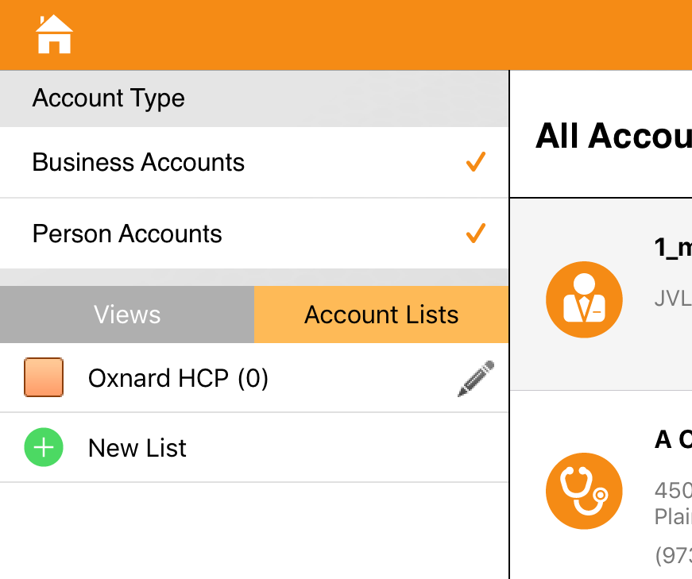
Account Lists
Users can create and manage Account Lists offline
Swipe from left to right to delete a target list or remove an account from the list

Slide 41
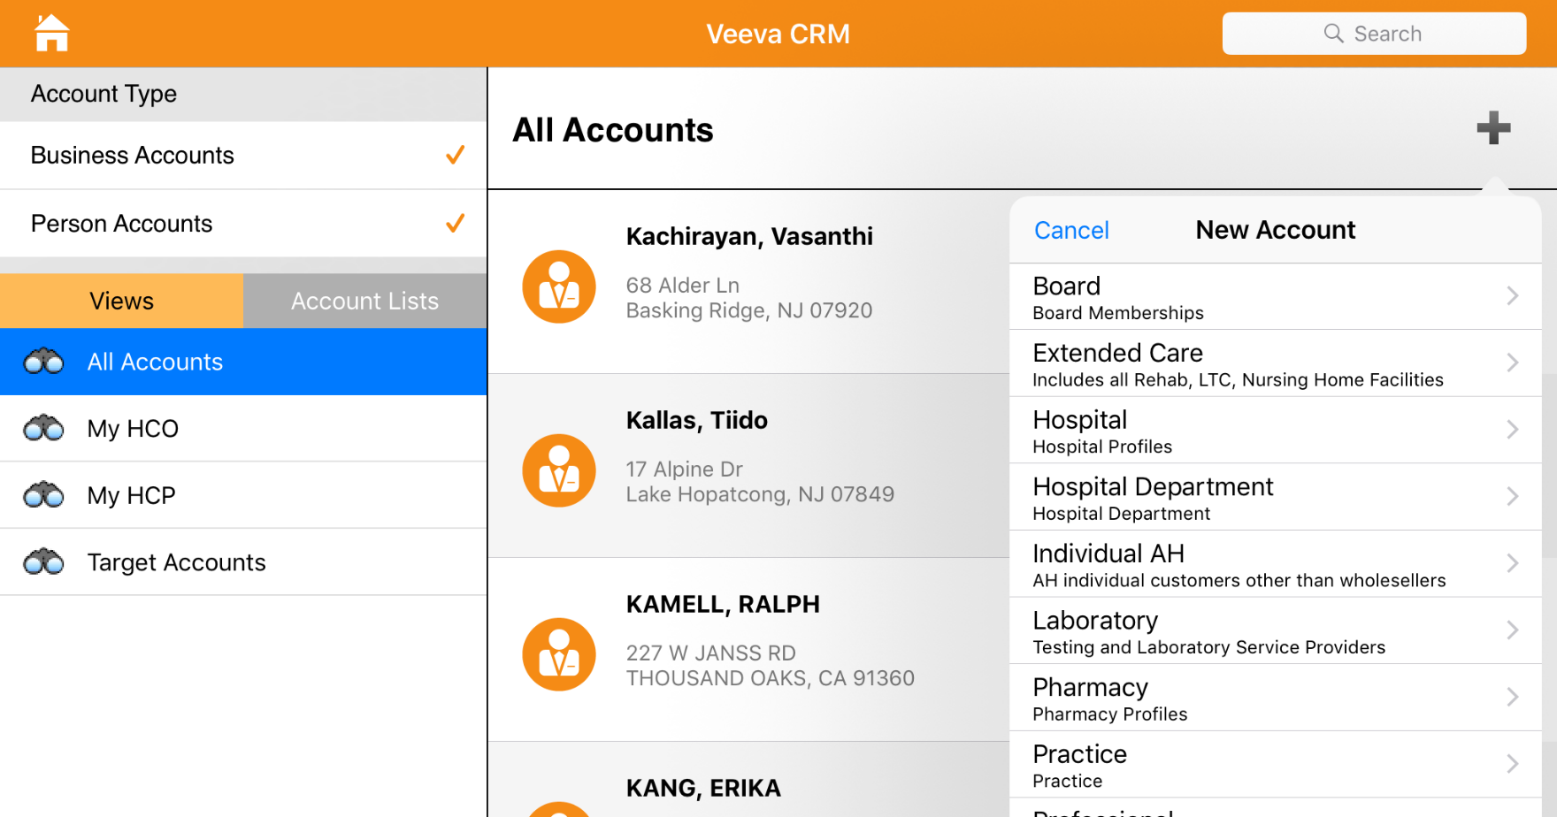
New Accounts in iRep
Click on ‘+’ Button to start
Select proper record type

Slide 42
Check Your Understanding ... 1
1. User can themselves add necessary account to their territory.
State True or False
True
False
Answer: True

Slide 43
Check Your Understanding ... 2
2. My accounts show data from which objects?
Accounts
Address
Territory Field
Product Metrics
All of the above
Answer: All of the above

Slide 44
Check Your Understanding ... 3
3. The Mass Update button on My Accounts page, DISABLE_MASS_UPDATE VEEVA is enabled by default.
State True or False
True
False
Answer: True

Slide 45
Check Your Understanding ... 4
4. Field Level Security combined with page layouts is used to control which fields are editable and visible by the users.
State True or False
True
False
Answer: True

Slide 46
Check Your Understanding ... 5
5. Account lists are _____ but views are _____.
Dynamic, Static
Static, Dynamic
Answer: Static, Dynamic

Slide 47

Summary
In this module, you have learnt to:
  Define the My Accounts tab
  Create Views
  Create Lists
  Configure the My Accounts tab
  Hide the Mass Update button
  Configure the Schedule a Call button
  Configure the New button
  Enable New Account Wizard
  Enable Parent Account Wizard
  Use the VEEVA Global Account Search
  Describe My Accounts on iRep

Slide 48
Source
https://crmhelp.VEEVA.com/doc/Content/Home.htm
https://trailhead.salesforce.com/en/home
Disclaimer: Parts of the content of this course is based on the materials available from the Web sites and books listed above. The materials that can be accessed from linked sites are not maintained by Cognizant Academy and we are not responsible for the contents thereof. All trademarks, service marks, and trade names in this course are the marks of the respective owner(s).

Slide 49
Coming Next ...
In the upcoming module - Account Object Configurations, you will learn to:
  Define VEEVA Account record types
    Business Account
    Person Accounts
    Defined custom Accounts fields
    Place custom fields on specific account page layout(s)
  Create custom page layout and record types
  Create a custom Account button
  Display the View User Territory custom link

Slide 50
Thank you
  You have successfully completed
  My Account Configurations

